Slide 1


Spin Distribution of Excited Nuclear States in ^{nat}Fe(p,αn)
Andrew S. Voyles, M.S. Basunia, L.A. Bernstein, J.W. Engle, E.F. Matthews, A. Springer
08 May 2017
6th Workshop on Nuclear Level Density and Gamma Strength

Slide 2
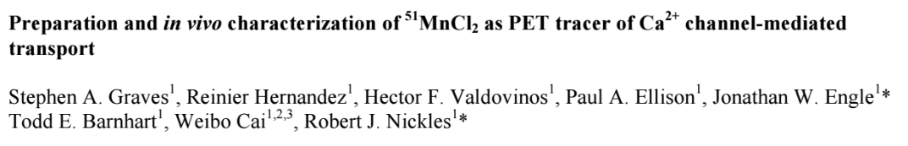
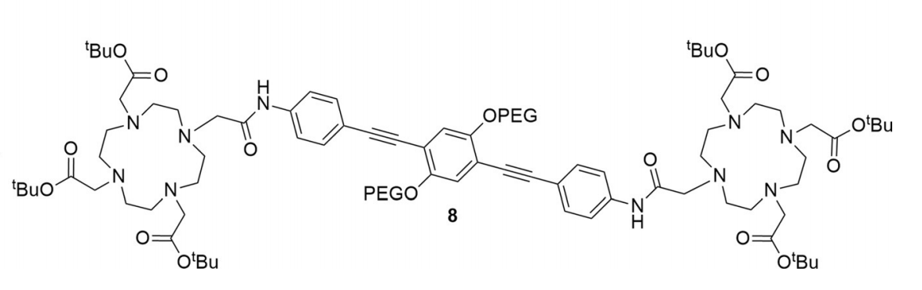
^{51,52}Mn - Motivation
Emerging medical radionuclides
⁵¹Mn (t_{1/2} = 46 min, 97% β⁺) – short-lived PET tracer for metabolic studies
^{52g}Mn (t_{1/2} = 5.6 d, 29% β⁺) – long-lived PET tracer for neuron tracking, immune studies
Manganese has well-established biochemistry and uptake via DOTA-based chelation
Almost no Fe(p,x) XS measurements exist – can use these to probe spin physics in the A≈50 region
Mn
Mn

Slide 3
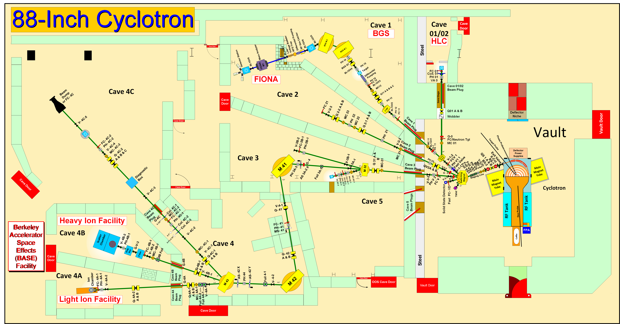
Methodology

Slide 4
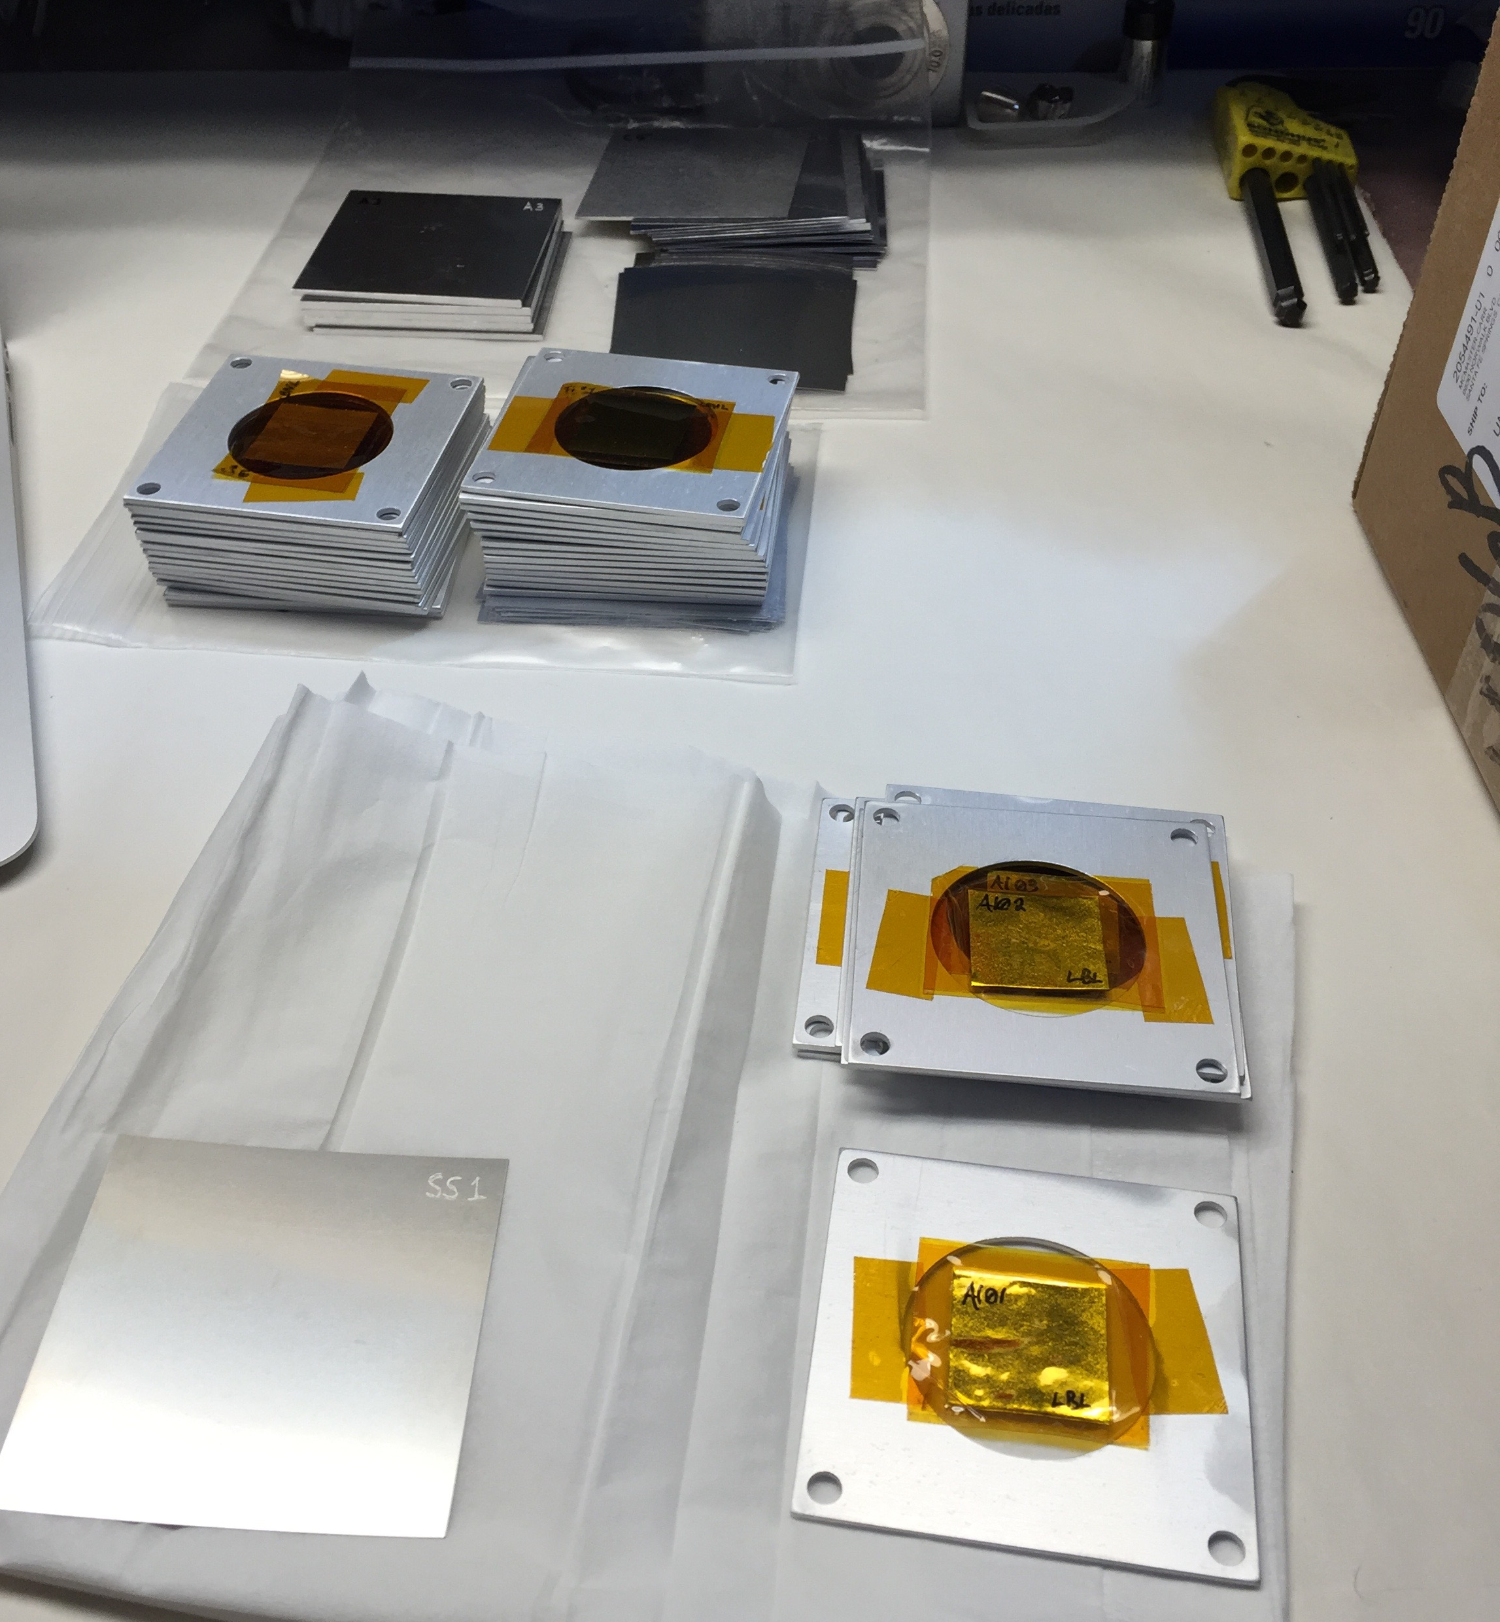
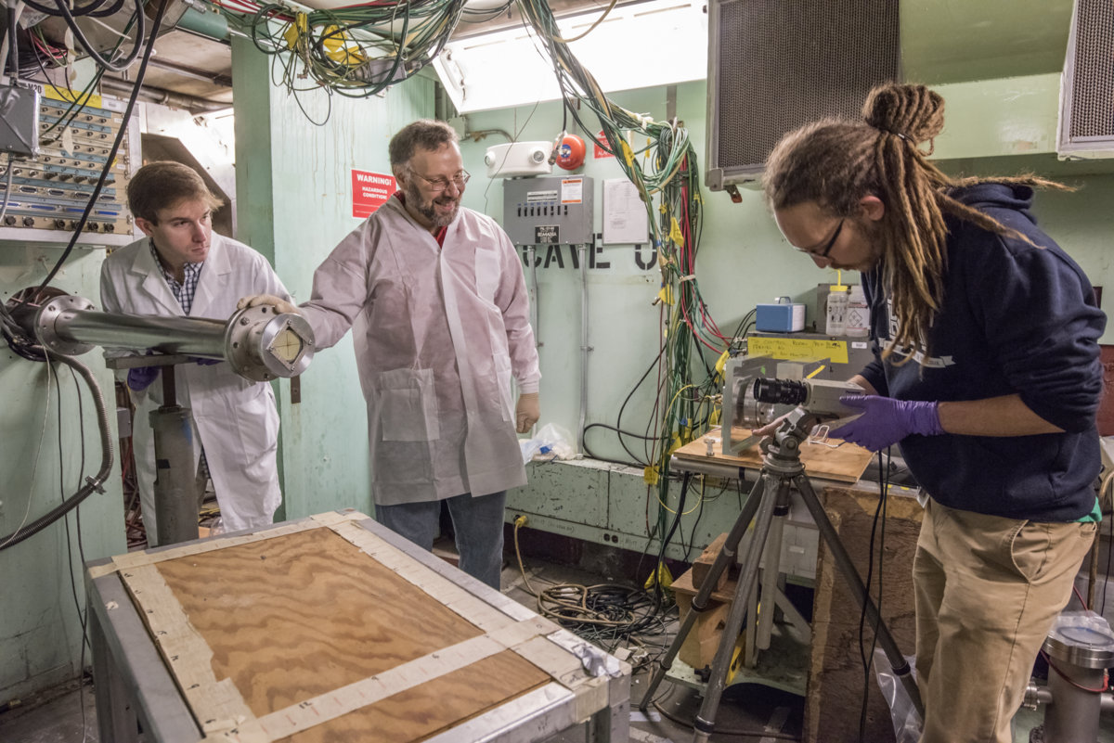
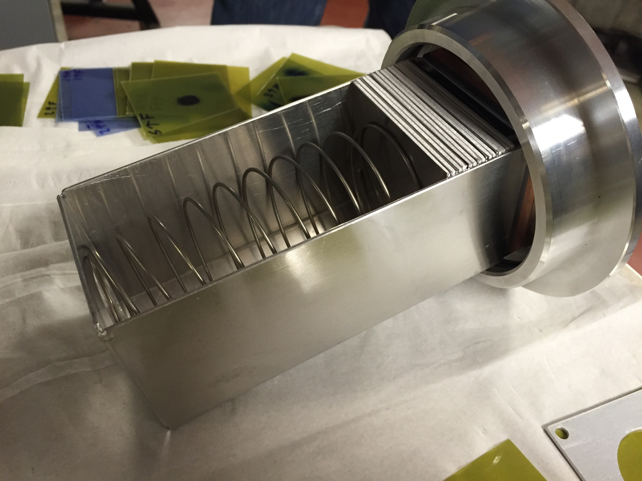
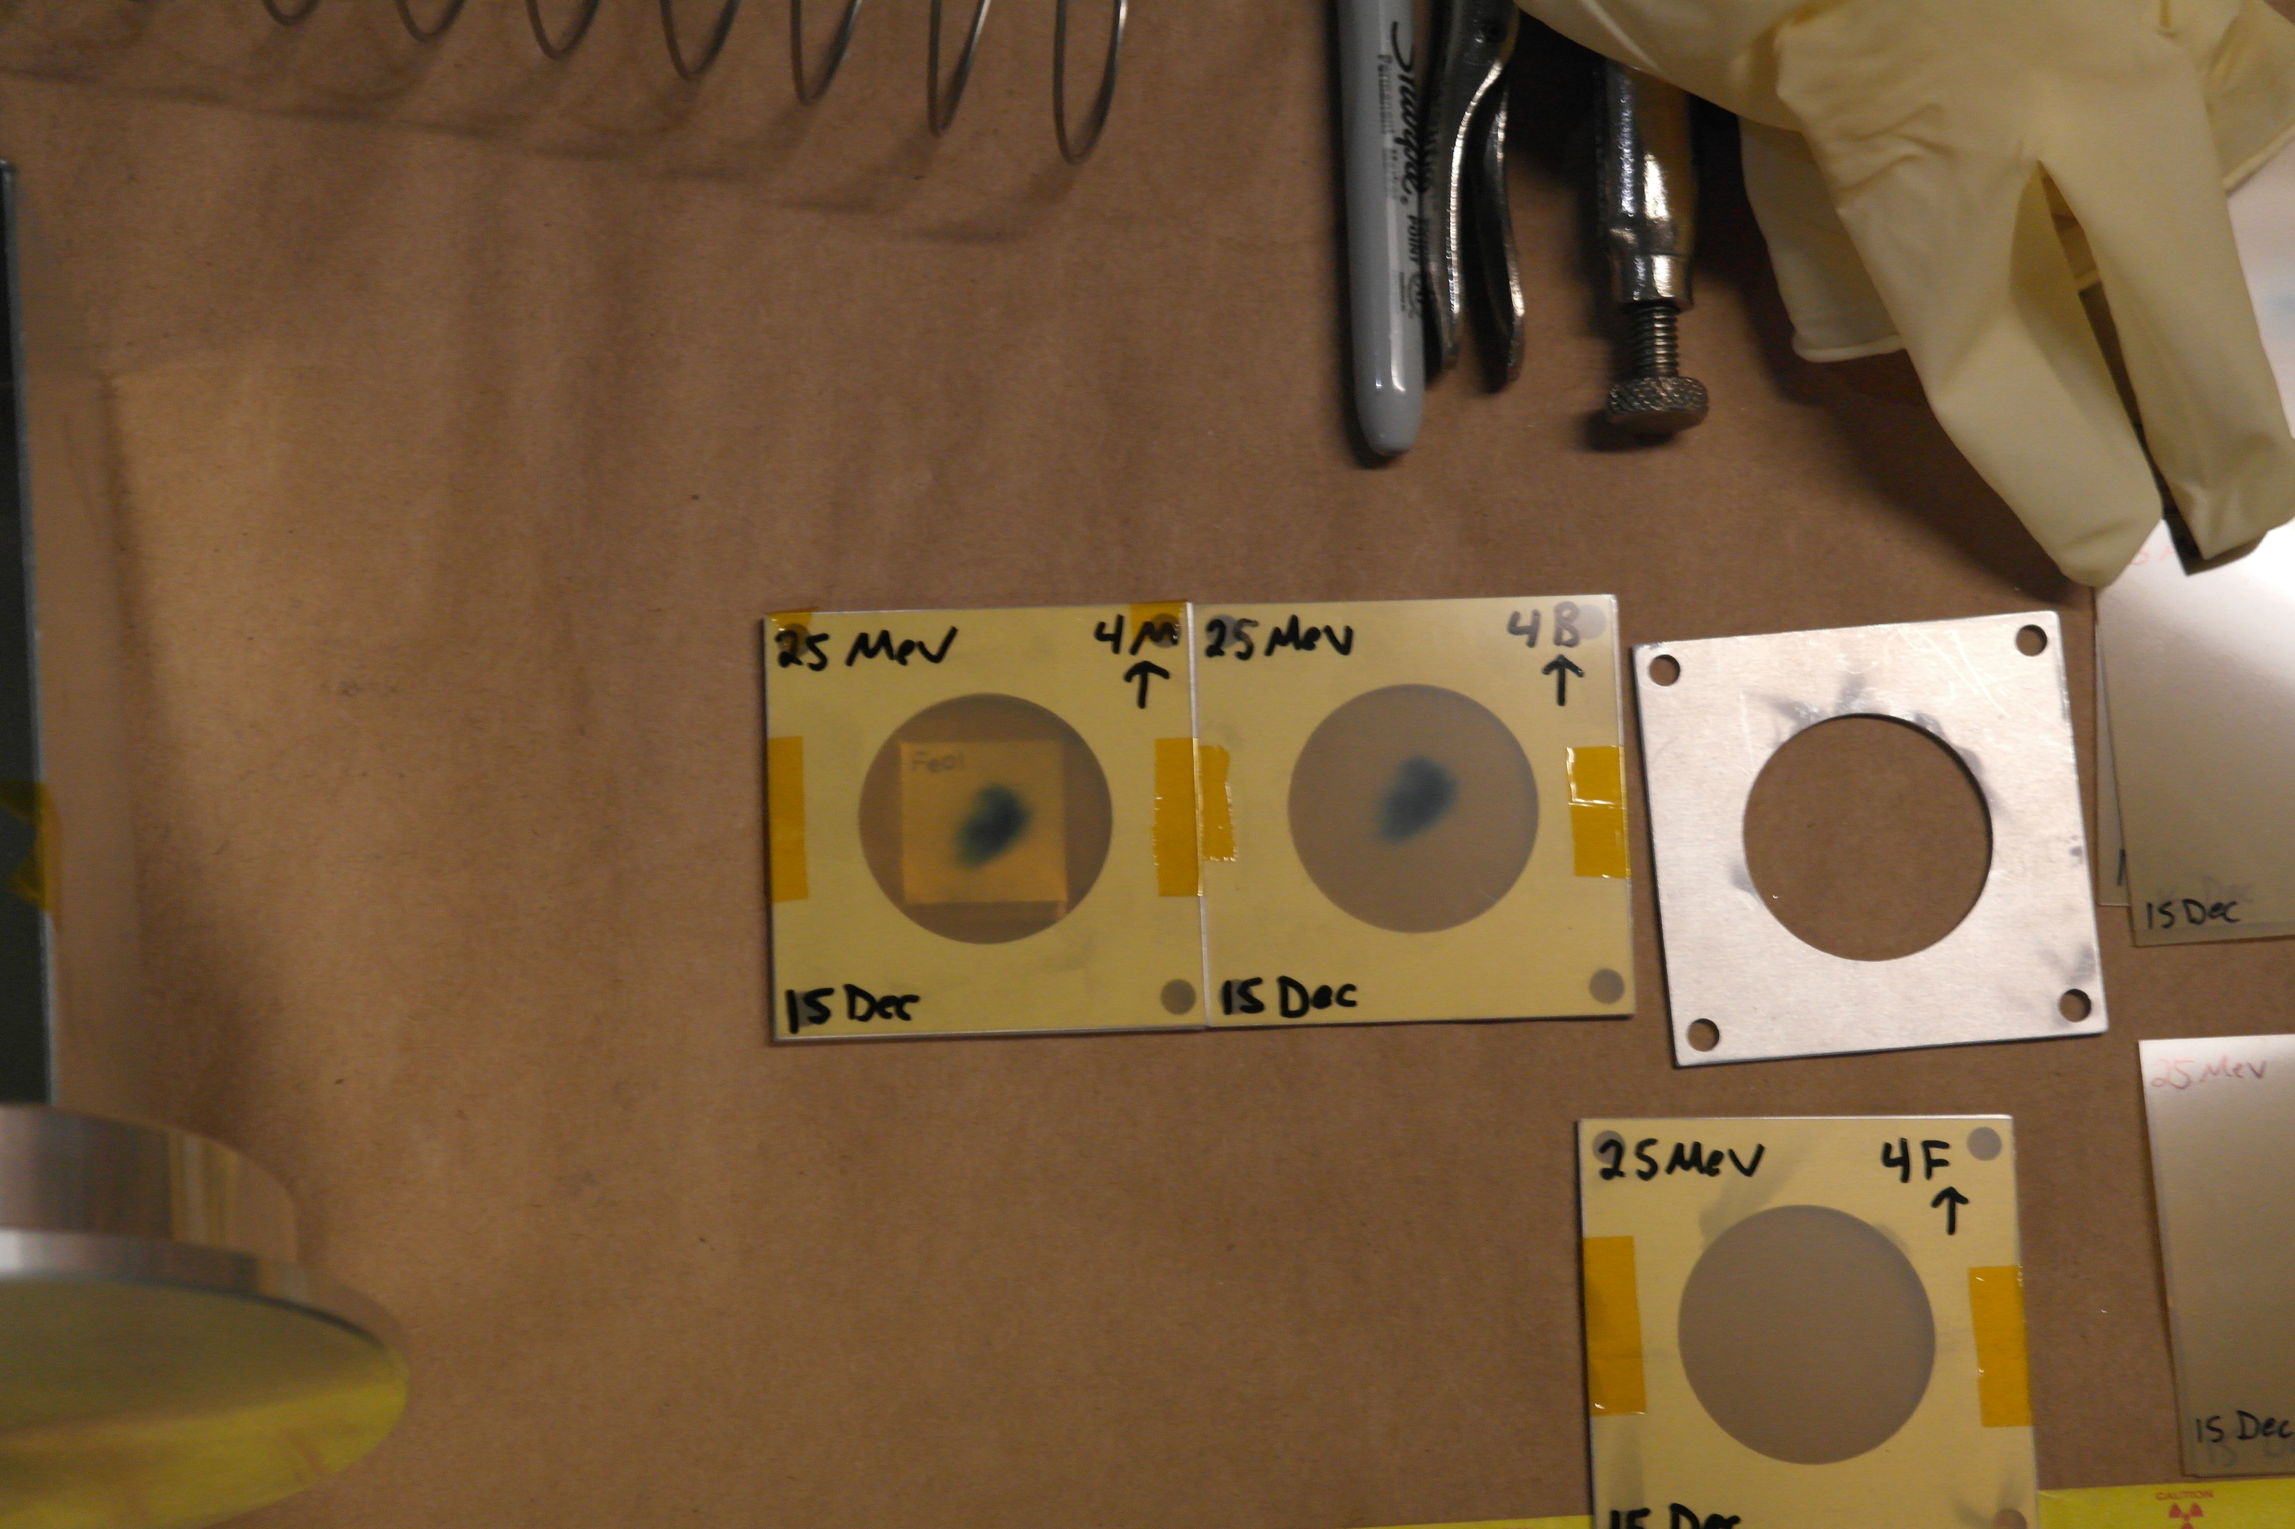
A. Springer
L. Bernstein
2.5 cm
Two overlapping stacks: E_{p}= 55→21 MeV, 25→11 MeV

Slide 5
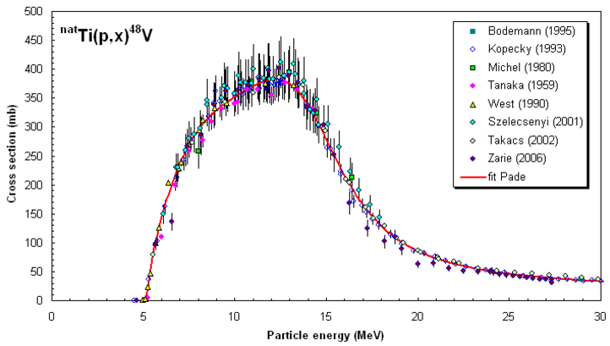
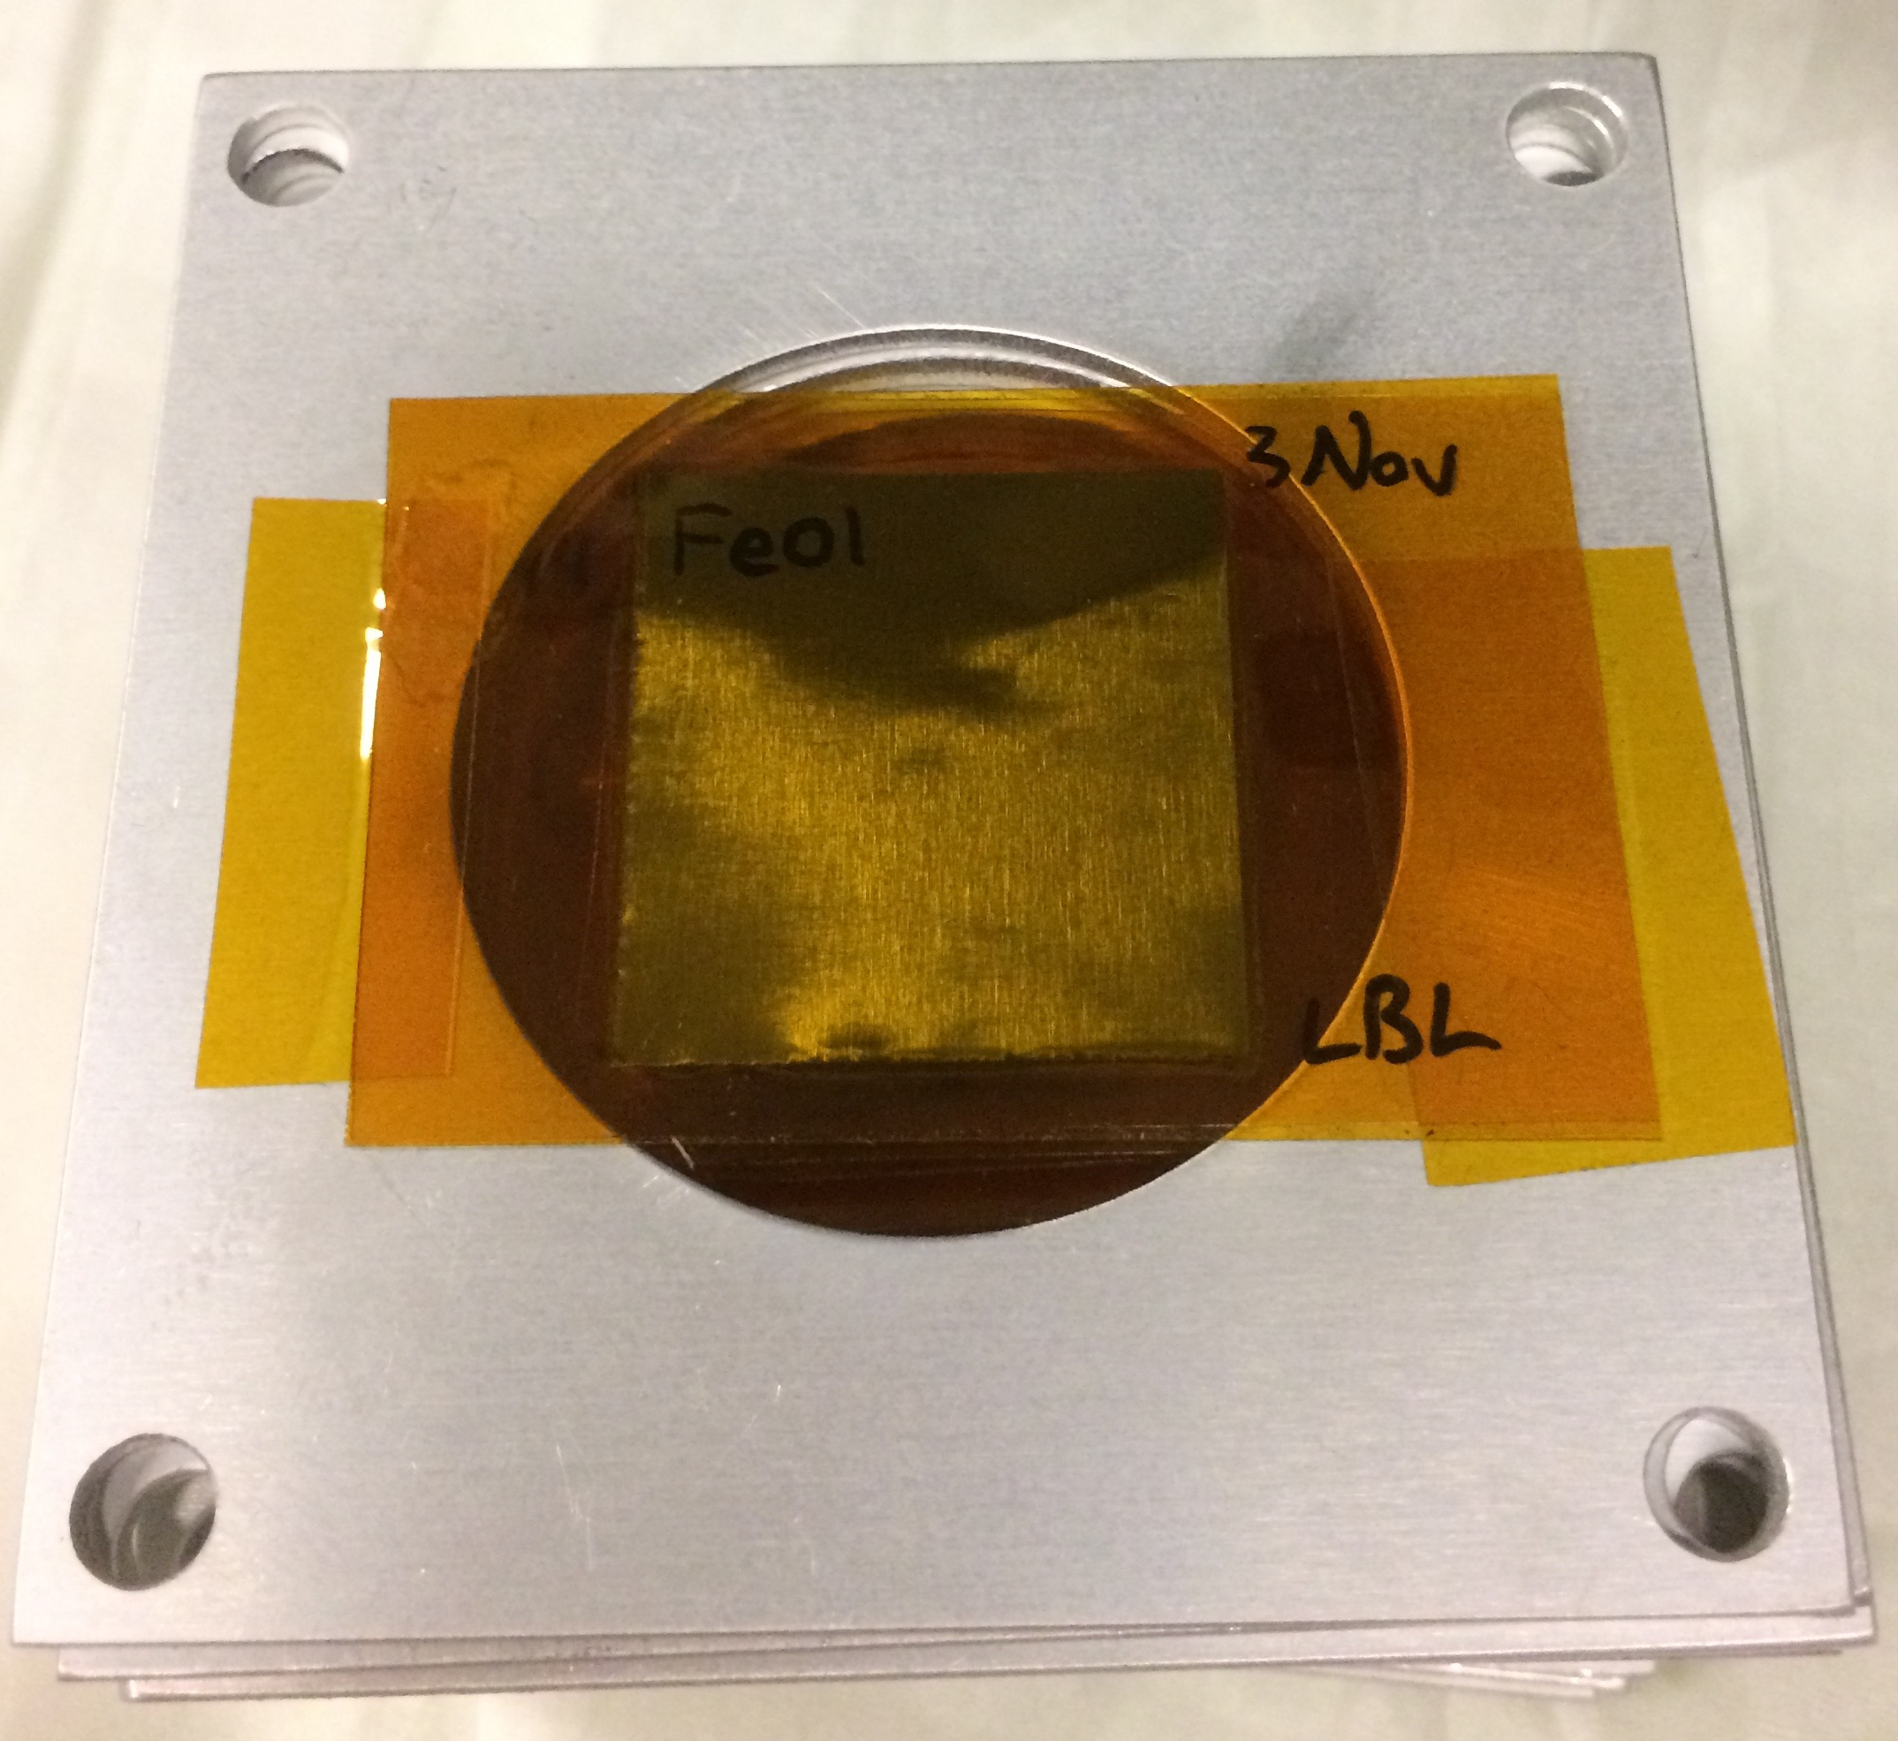
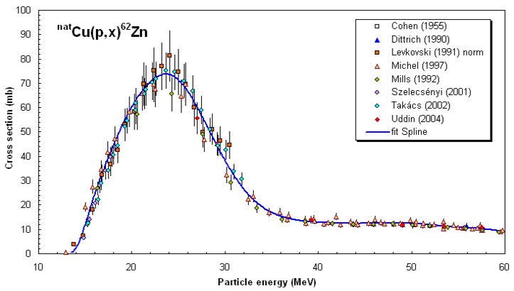
25 μm-thin ^{nat}Fe, ^{nat}Cu, ^{nat}Ti foils in 0.1” Al frames
2.5 cm
Dosimetry: IAEA charged particle beam monitor reactions:
^{nat}Ti(p,x)⁴⁸V
^{nat}Cu(p,x)^{62,63,65}Zn
nds.iaea.org/medical/monitor_reactions.html

Slide 6
Fe(p,x)
Cu(p,x)
Ti(p,x)

Slide 7
Preliminary

Slide 8
Preliminary
Results consistent with R≈1 at high energy.
At low energy, results are ambiguous due to energy straggling.

Slide 9
Measurements @ LANL – Nb(p,x)
^{nat}Nb(p,4n)⁹⁰Mo is a high-priority objective as a new proton beam dosimetry standard for E_{p} ≈ 50 – 100 MeV
Z
ε+β⁺ |  |  | ⁹⁰Mo |  |  | ^{93m}Mo | ⁹⁴Mo
IT |  |  | ^{89m}Nb ⁸⁹Nb | ⁹⁰Nb | ^{91m}Nb | ^{92m}Nb | ⁹³Nb
 | ⁸⁶Zr |  | ⁸⁸Zr | ⁸⁹Zr
 |  | ⁸⁶Y | ^{87m}Y ⁸⁷Y | ⁸⁸Y
⁸³Sr |  | ^{85m}Sr
^{82m}Rb |  |  |  |  |  |  |  | β⁺⁻
^{100 MeV} ^{p+}
N

Slide 10
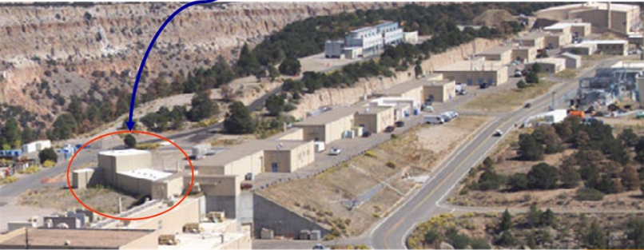
Measurements @ LANL – Nb(p,x)
IPF
Proton Injectors
201.25 MHz Drift Tube Linac
p+
805 MHz Side-Coupled Cavity Linac
To research centers
p+
p-
800 m
p-
750 keV
100 MeV
800 MeV
h+

Slide 11
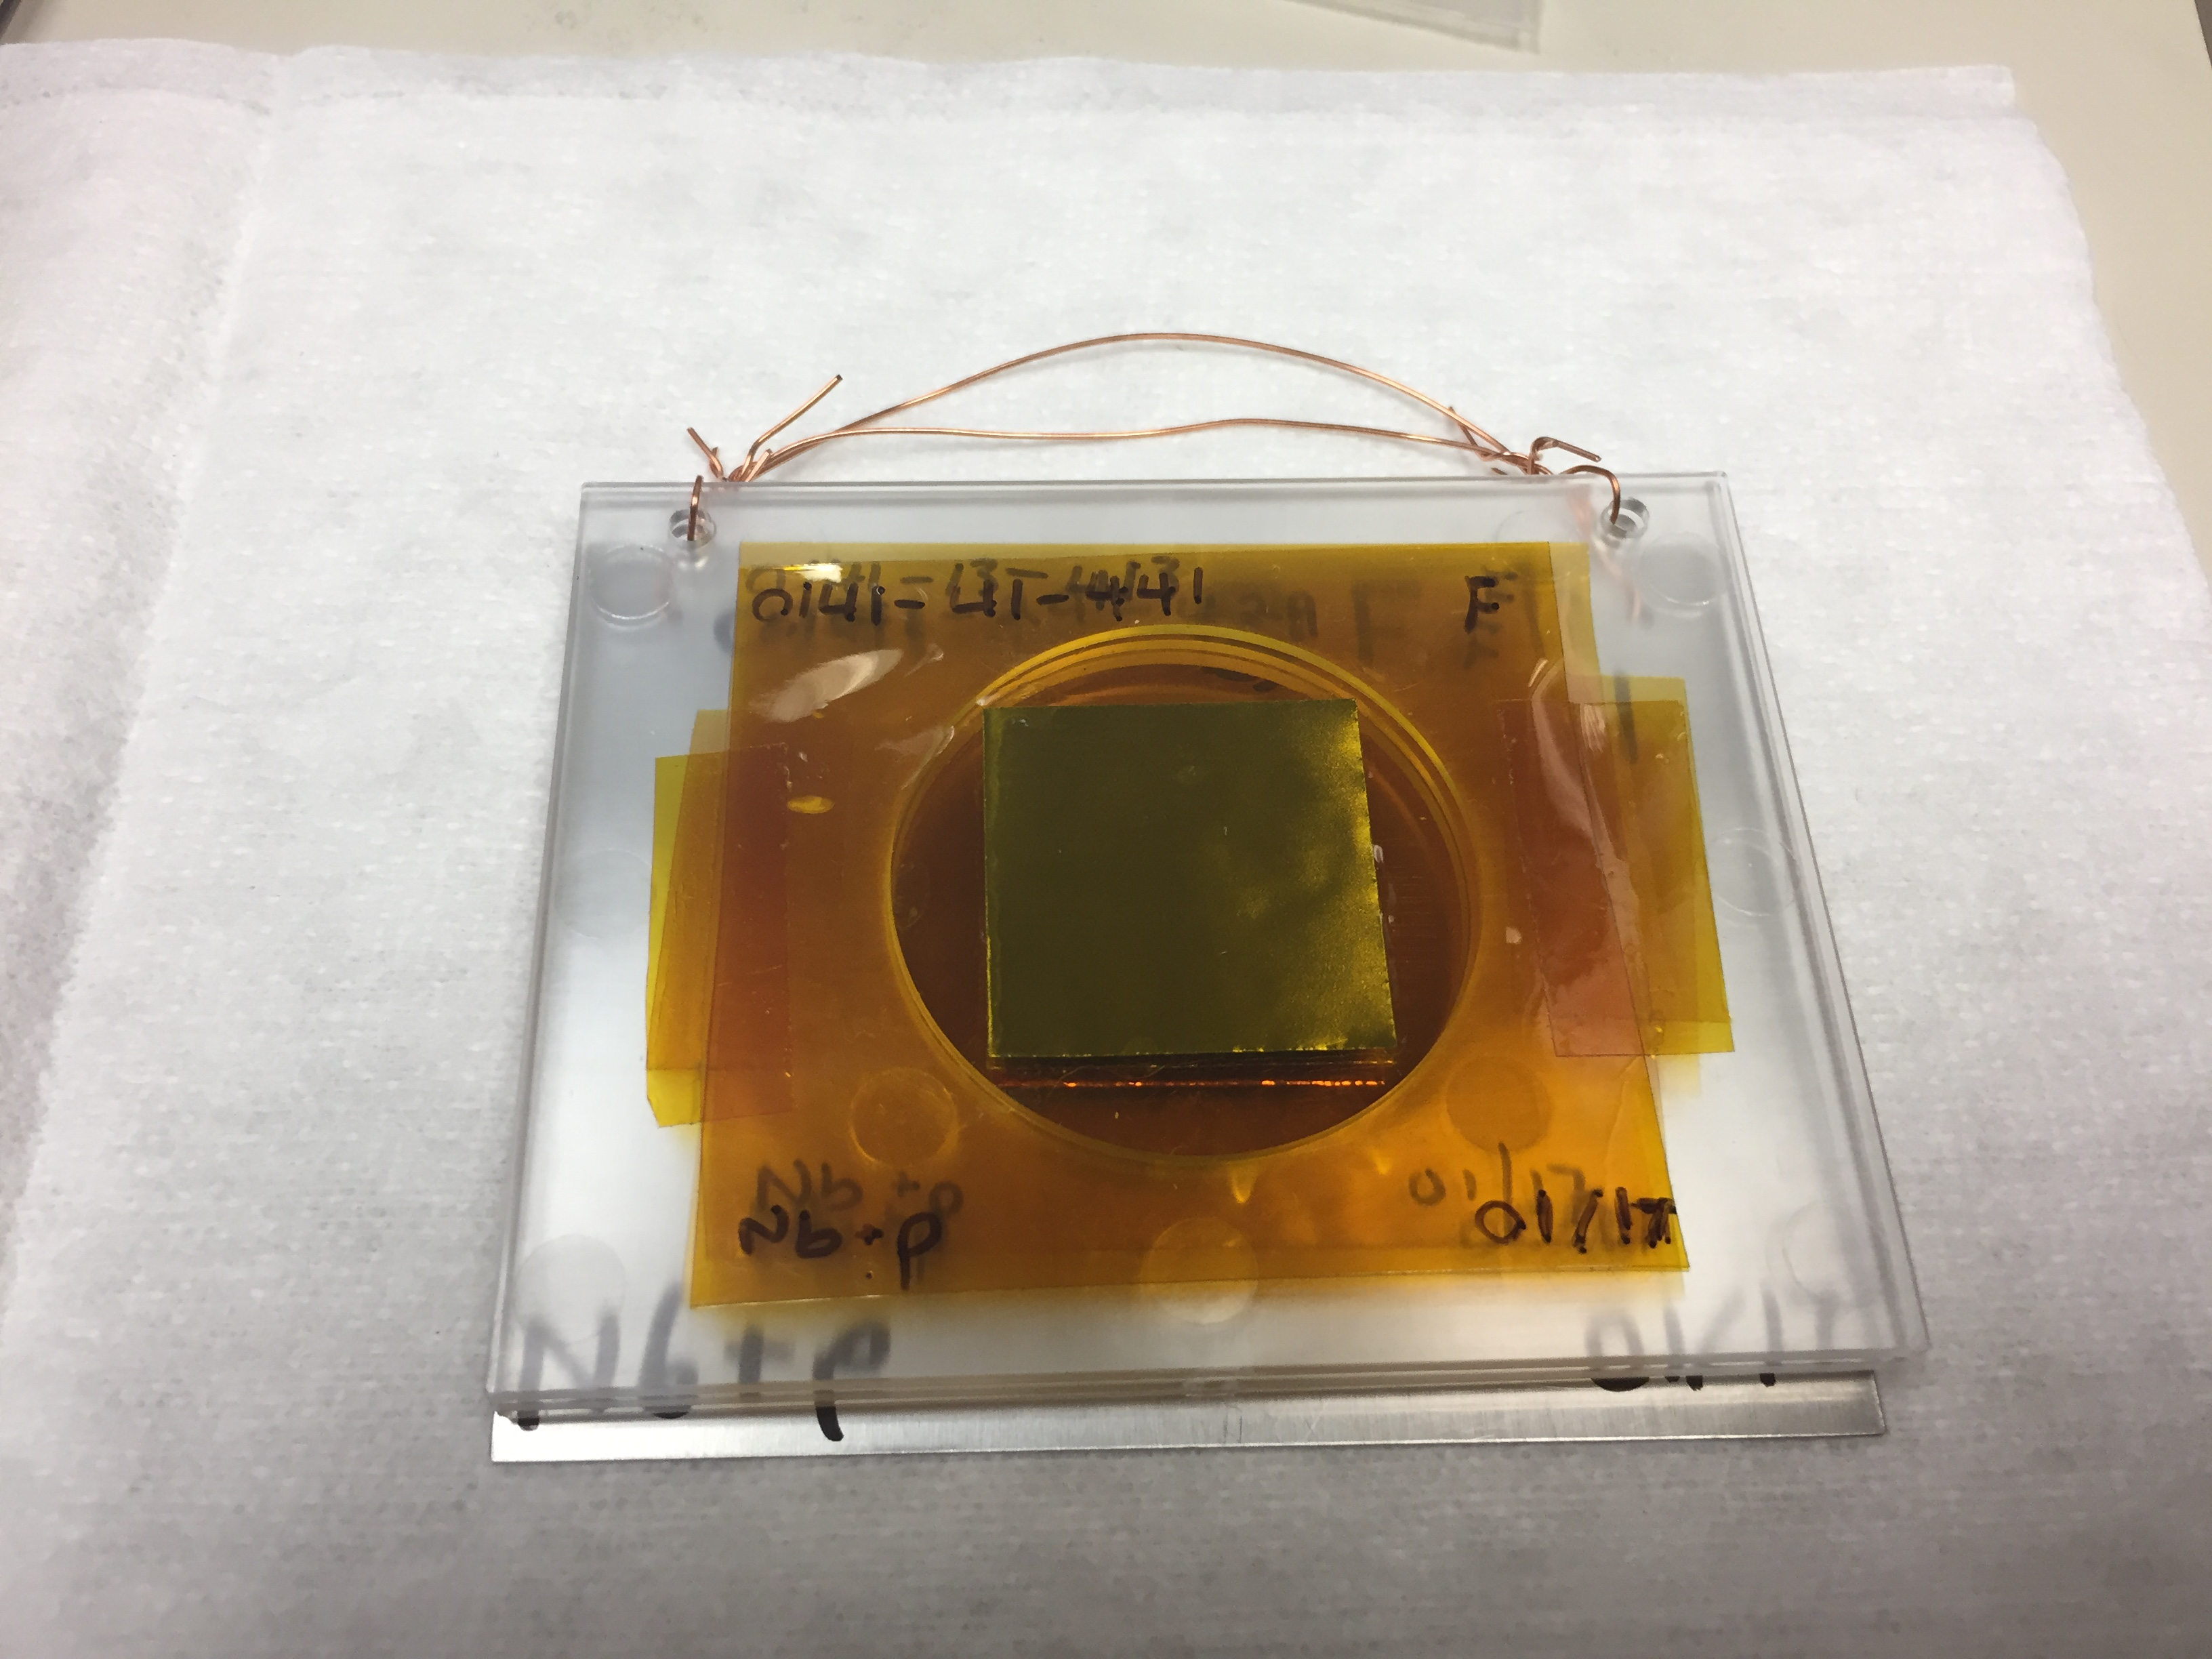
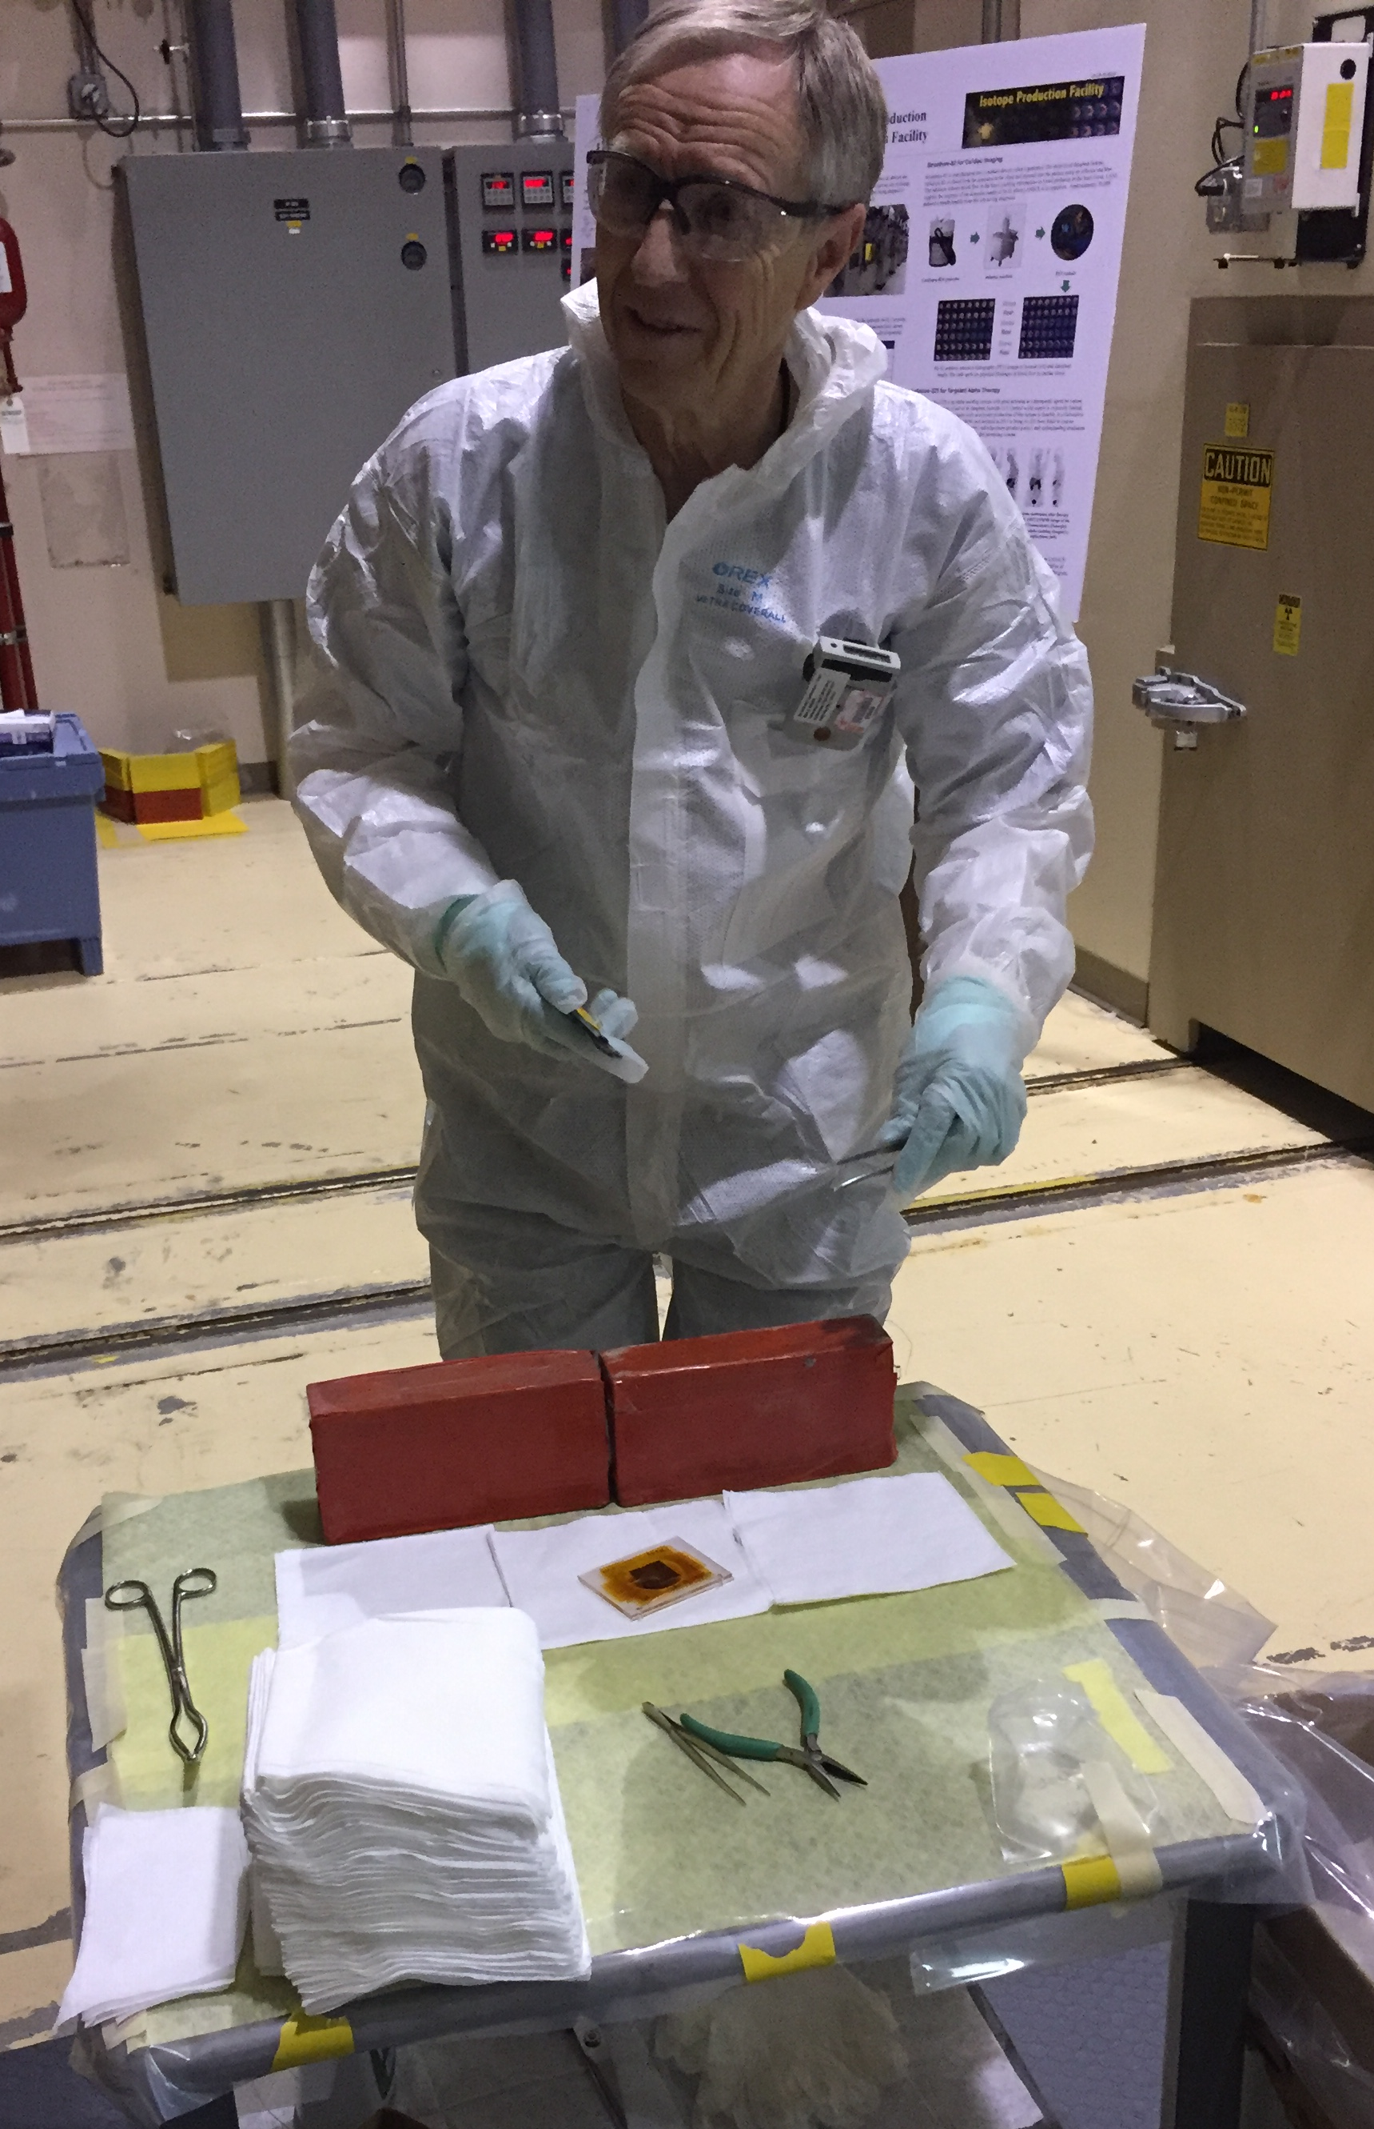
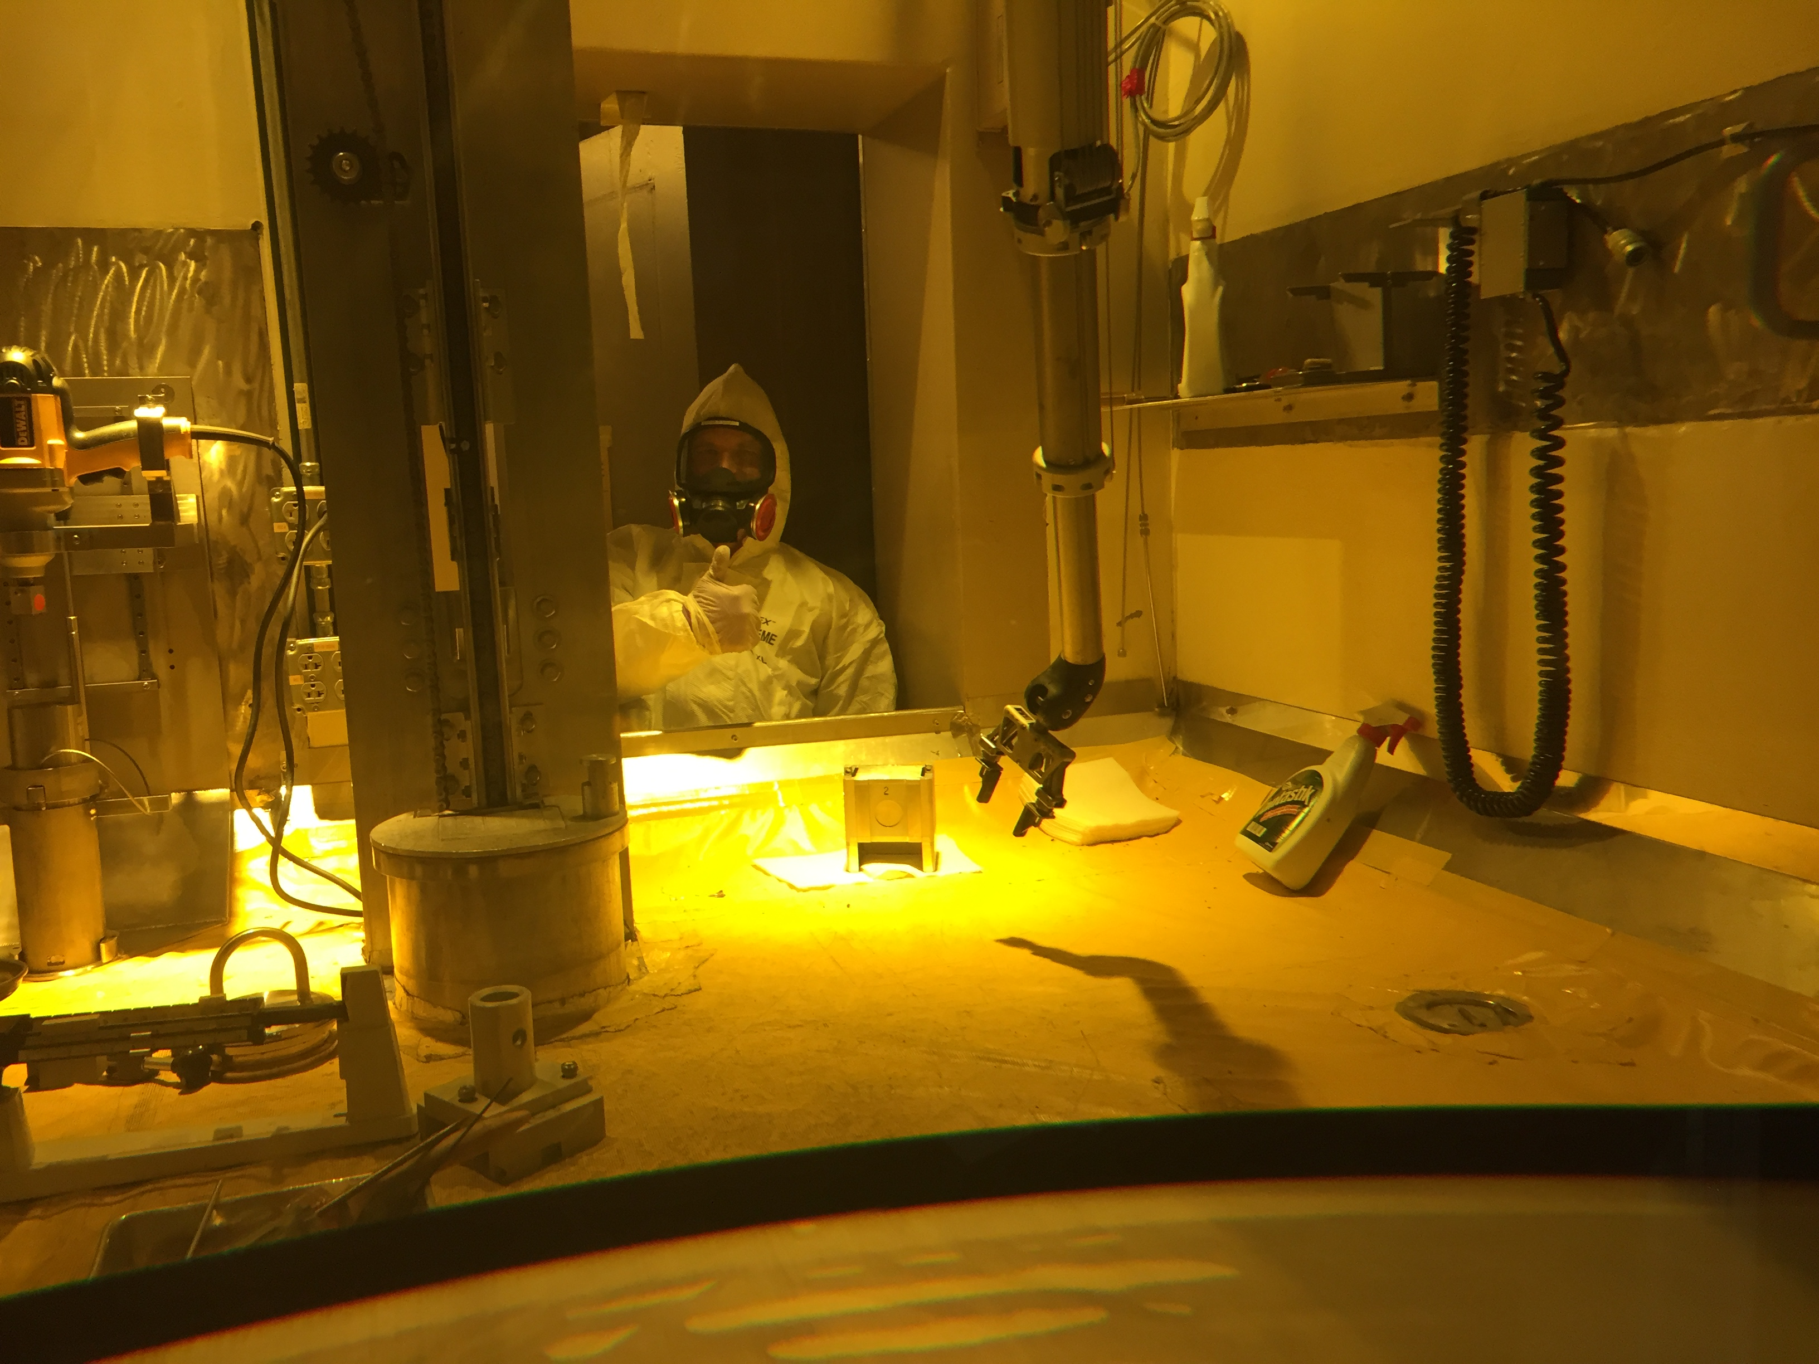
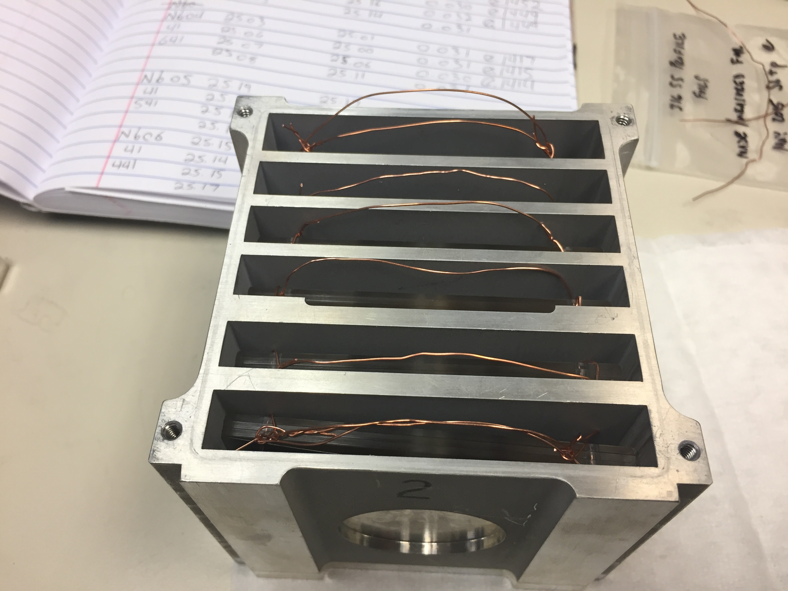
Measurements @ LANL – Nb(p,x)
LBNL: 5 – 55 MeV / A, LANL: 45 – 100 MeV p⁺
Complementary measurements explore reaction dynamics in different energy regimes, overlap region of 45-55 MeV builds confidence and consistency in results.
M. Nortier
^{100 MeV p+}

Slide 12
Measurements @ LANL – Nb(p,x)
Preliminary

Slide 13
Summary
Demonstrated ability to measure R_{spin-cut} in excitation function studies for emerging medical radioisotopes
Already completed: Fe(p,x), Zr(d,x), Nb(p,x)
Upcoming targets: ⁸⁶Sr(p,x)⁸⁶Y, La(p,x)^{134,135}Ce, ¹⁷⁷Hf(n,p)¹⁷⁷Lu
⁷Li(p,n) quasi-monoenergetic neutron source development
Possible future candidates: Access targets previously fielded by β⁺-Oslo in the A≈50,90, rare earth regions via (p,xn), (α,xn)

Slide 14

Tusen takk!

Slide 15
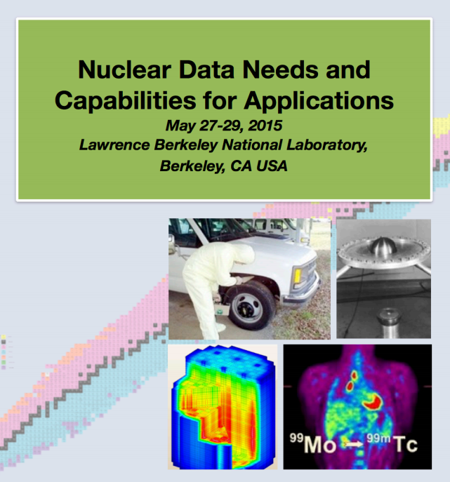
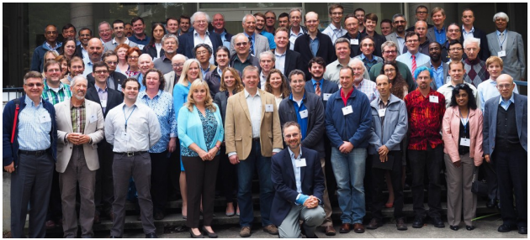
Some perspective
Notes:
Dr Qaim - plenary speaker and instigator of priority isotopes

Slide 16
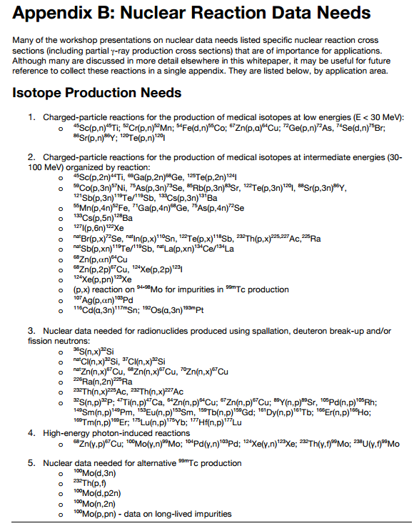
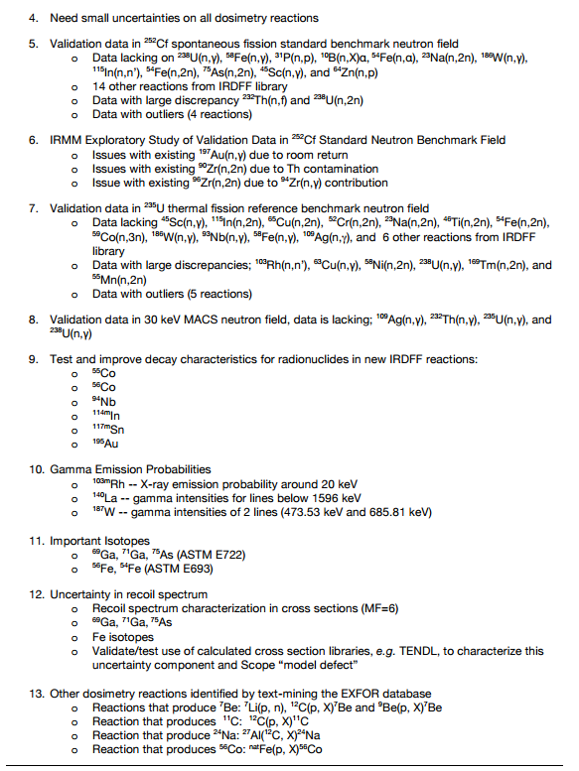
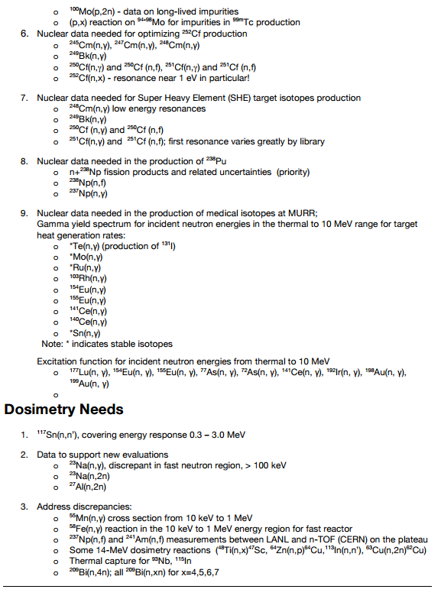
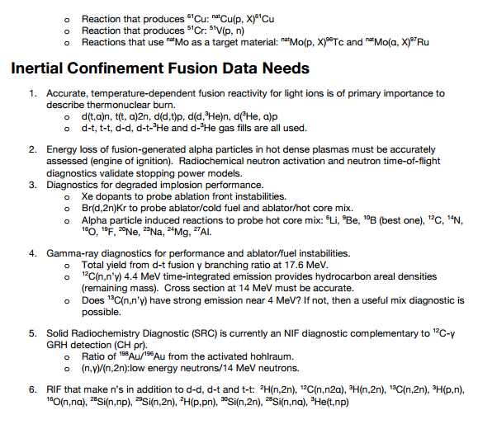
Some perspective
Highlight from WTTC 2016: ⁵⁴Fe(p,α)⁵¹Mn
NDNCA Whitepaper available at http://bang.berkeley.edu/events/ndnca/whitepaper/

